Slide 1
Past Continuous

Slide 2
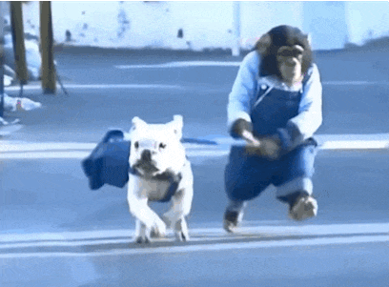
De Past Continuous gebruik je voor
Iets dat in het verleden bezig was, vaak terwijl er iets anders gebeurde.
I was walking the dog when it started to rain
Ik was de hond aan het uitlaten toen het begon te regenen

Slide 3
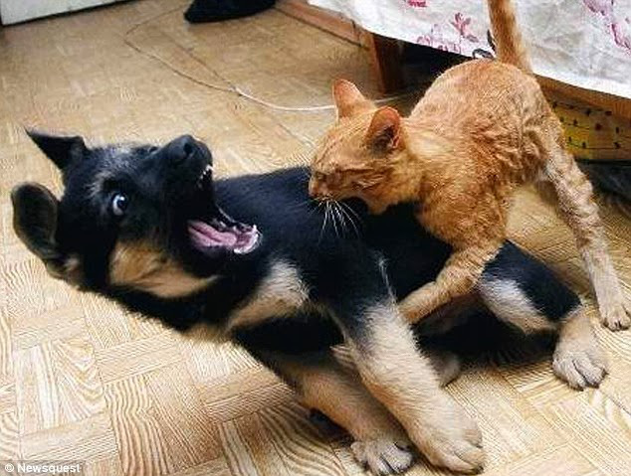
De Past Continuous gebruik je ook
Om een ergernis uit te drukken over iets wat vroeger steeds gebeurde
My brothers were constantly arguing when they still lived at home.
Mijn broers hadden continu ruzie toen ze nog thuis woonden

Slide 4
Was / were + ww. + ing
Was = I, he, she, it
Were = we, you, they

Slide 5
Practice makes perfect
were eating
They ……………… (eat) dessert.
We …………..… ……(watch) tv when the phone …….... (ring).
The fire ………………… (spread) quickly!
It’s no wonder you received a ticket, you ………………… (drive) way too fast!
I …………... (speak) with James yesterday.
My parents ……………………. (not + sleep) when I ……………. (get) home late last night.
were watching
rang
was spreading
were driving
spoke
weren’t sleeping
got

Slide 6
De Past Continuous gebruik je voor
Iets dat in het verleden bezig was, vaak terwijl er iets anders gebeurde.
De Past Continuous gebruik je ook
Om een ergernis uit te drukken over iets wat vroeger steeds gebeurde
Was / were + ww. + ing
Was = I, he, she, it
Were = we, you, they

Slide 7
Past simple, present perfect, past continuous
When………you…………… your homework?
We …………..… ……(read) the news paper when the phone …….... (ring).
The fire ………………… (spread) quickly!
I ……… never ………… (drive) a station wagon before.
I …………... (speak) with James yesterday.
My parents ……………………. (not + sleep) when I ……………. (get) home late last night.
did do
were reading
rang
was spreading
have driven
spoke
weren’t sleeping
got

